Slide 1
Release Management

Slide 2
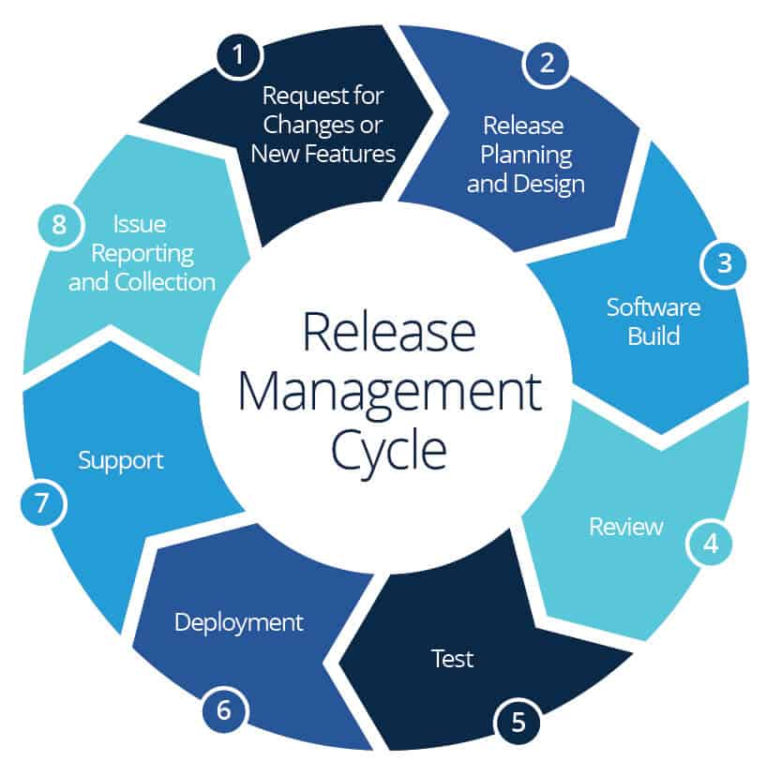
Release management is the process of managing, planning, scheduling and controlling a software build through different stages and environments
CRQ: Means change Request
CAB: change-advisory board
Change Management focuses on smoothly transitioning new initiatives from development into operations.

Slide 3
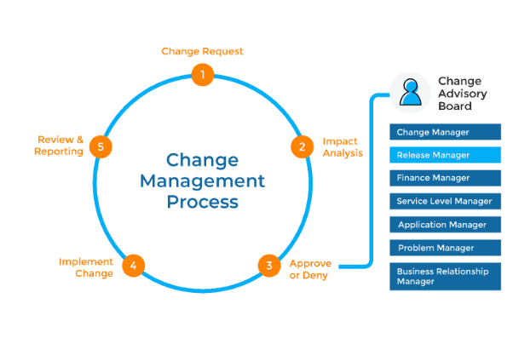
Release Management is primarily concerned with the flow of changes through various pre-production environments, culminating in successful deployment into the production IT environment.

